Slide 1
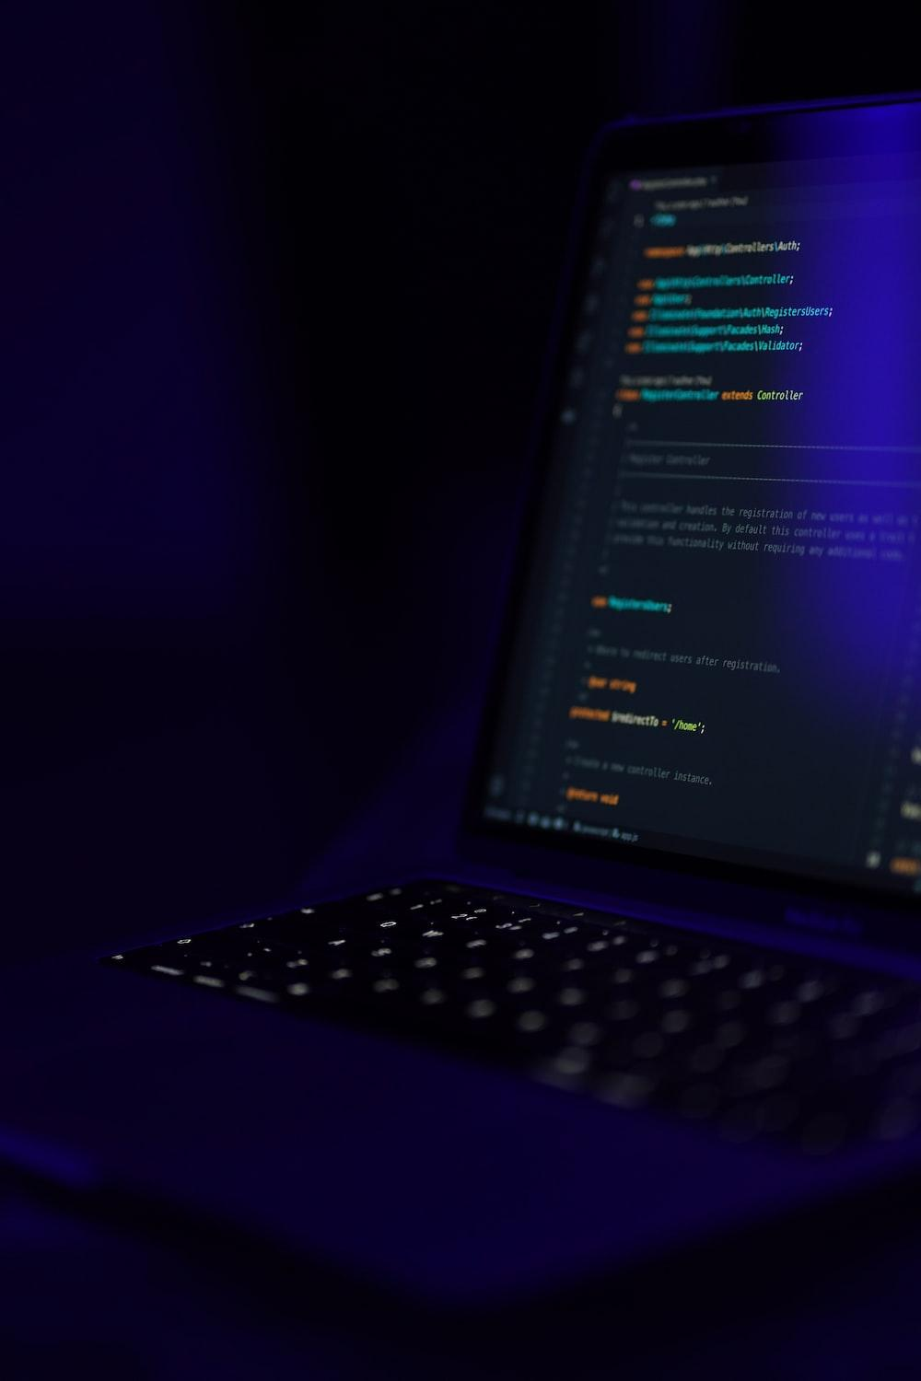
Cartoonify an image with opencv in python
onify an image with opencv in python

Slide 2
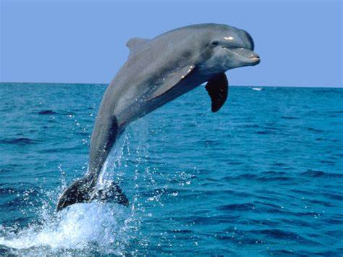
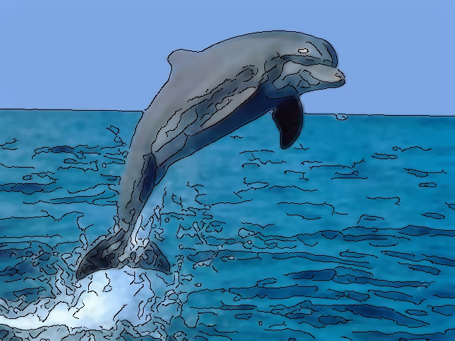
Objective
With the recent success of Instagram, the popularity of simple and fun photo effects apps has been on the rise.Our project allows users with both the means to capture images,and the computational power to perform sophisticated processing on these images. Cartoonify seeks to leverage the existing OpenCV library in order to emulate a particular cartoon effect.

Slide 3
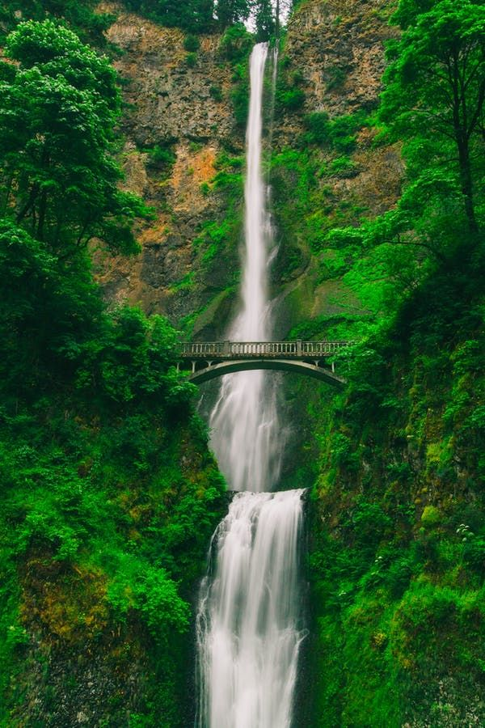
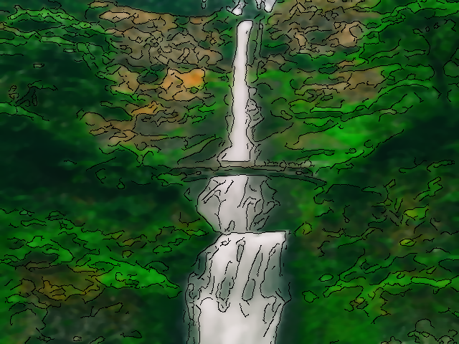
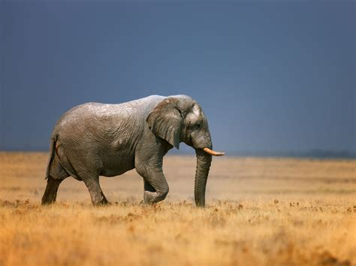
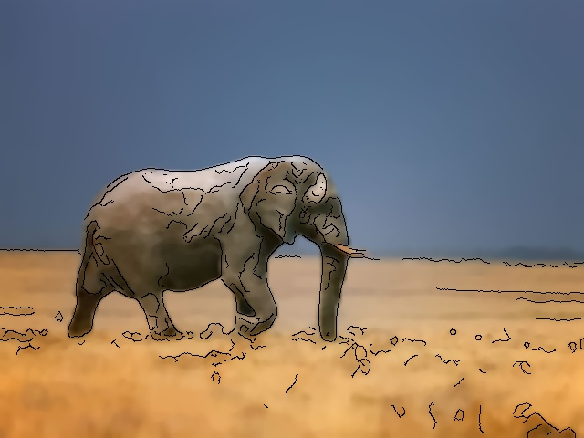
Original to Cartoonified image

Slide 4

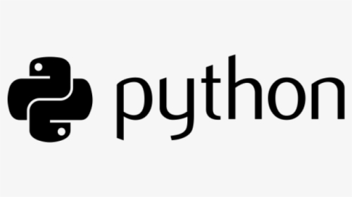


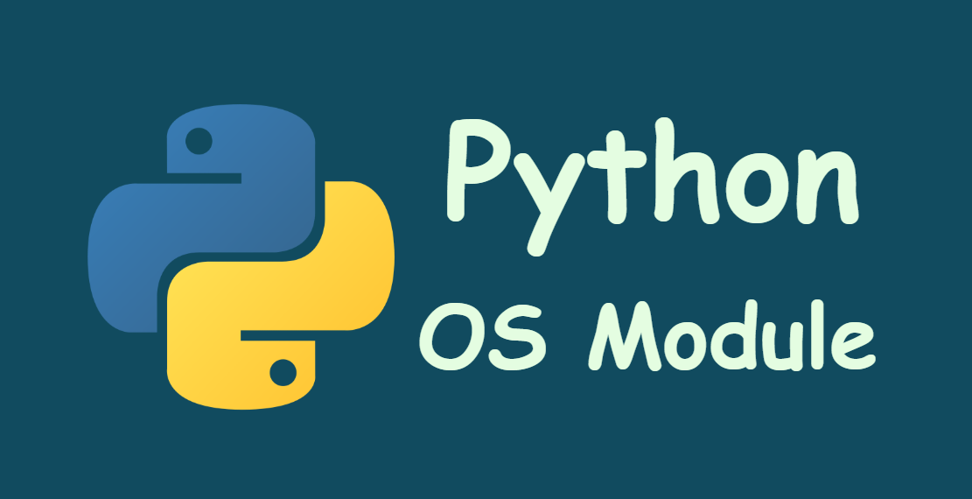

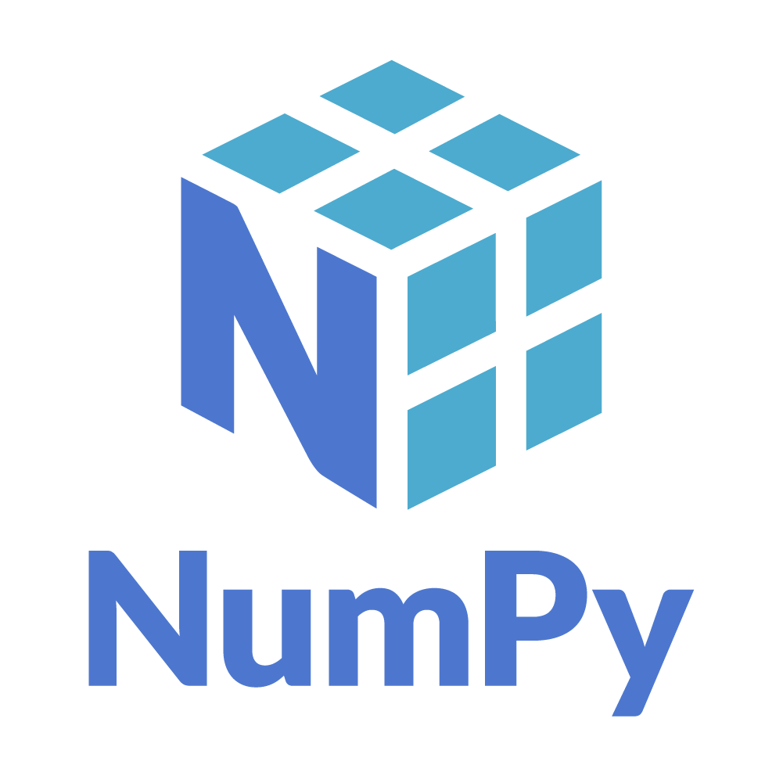
What we have used :
LANGUAGE:
LIBRARIES:
1
4
2
IDE:
5
3

Slide 5
Algorithm used :
Edges
Edge Detection
Morphological Operations
Colors
Bilateral Filter
Median Filter
Recombine

Slide 6
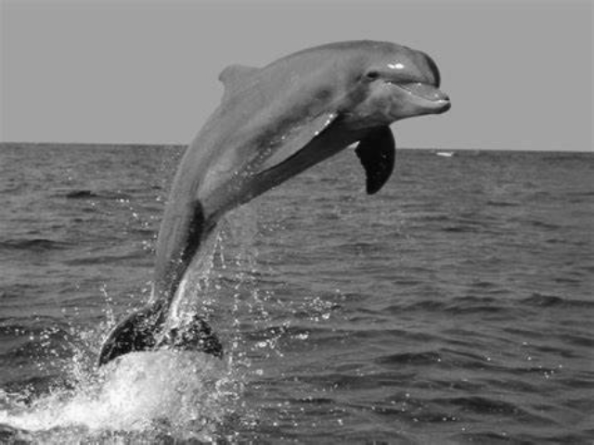
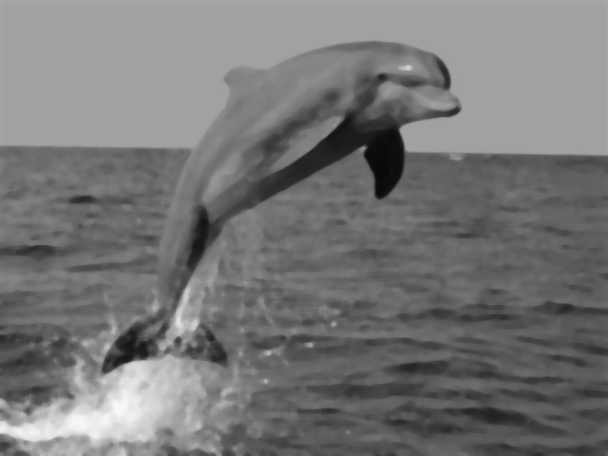

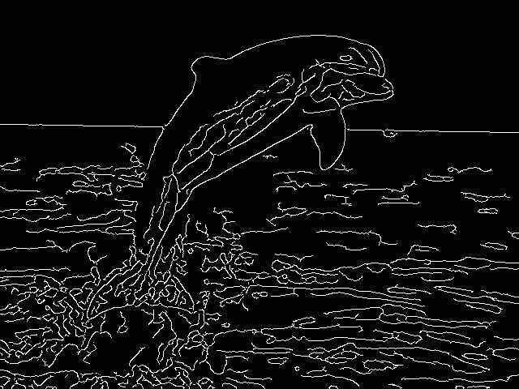
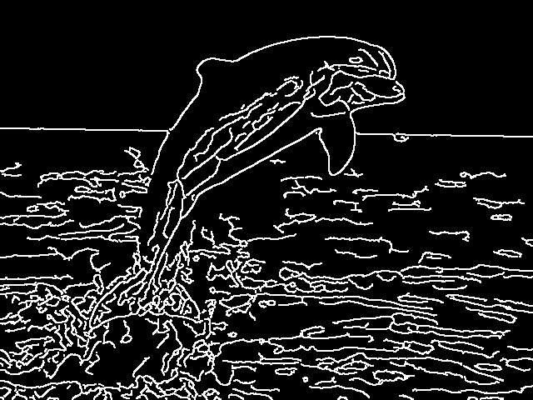
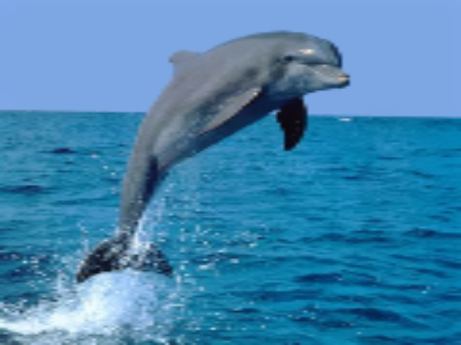
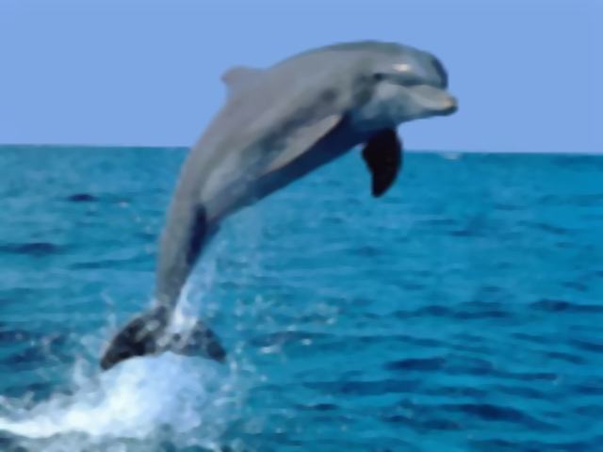

Steps :
1
2
3
4
5
6
7
8
9

Slide 7
How it works :
This algorithm has two main processing chain. One is to create the edge mask and other is to smoothen the colors of the images.
Once, both the color and edge image processing chains are complete, the only task left is to overlay the edges onto the color image.
The final algorithm simply draws the edge over the smoothened image to produce the final cartoonized image.

Slide 8
CONCLUSION:
We have made an application that allows users to cartoonify an image of their choice and save it on their system. Our application makes use of the opencv library for processing the image. With the help of tkinter we were able to make a gui for our application. During the development process we came to know about image processing and how it works.

Slide 9
Team CSE 3rd year 5th sem
SHWETA BHAGAT 11900120090
PREETAM DAS 11900120071
KARNASISH ROY 11900121201
SAGNIK SAHA 11900120021
PARNA DAS 11900120069
MAYUREE DAS 11900120074
ARNAB SAHA 11900120073

Slide 10
Thank You

